Slide 1
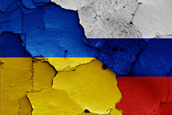
SEPARATED AT BIRTH:
THE ROOTS OF THE CURRENT CONFLICT & WHY RUSSIA AND UKRAINE ARE DIFFERENT

Slide 2
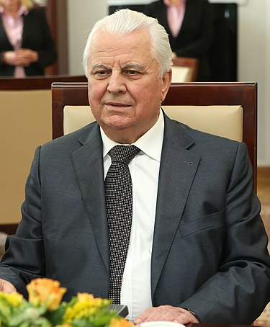
The formative twin crises of 1993-94
This Photo by Unknown Author is licensed under CC BY-SA
This Photo by Unknown Author is licensed under CC BY-SA

Slide 3
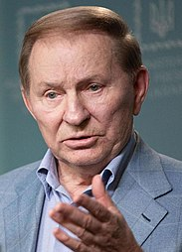
The Ukrainian resolution
Early elections for president and parliament
First peaceful transfer of power
Precedent for competitive elections and orderly transitions
This Photo by Unknown Author is licensed under CC BY-SA
This Photo by Unknown Author is licensed under CC BY-SA

Slide 4
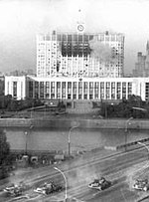
The Russian resolution
Shelling of parliament
Set precedent for executive-heavy system & resolution of political conflicts by force
This Photo by Unknown Author is licensed under CC BY-SA

Slide 5
Resonance in Ukraine
Competitive elections
Oligarchic pluralism
Vibrant civil society
This Photo by Unknown Author is licensed under CC BY

Slide 6
Resonance in Russia
Non-competitive elections
Suppression of civil society
Monolithic oligarchy
This Photo by Unknown Author is licensed under CC BY-SA-NC

Slide 7
Ukraine’s three post-Soviet revolutions
1994: First peaceful transfer of power in ex-USSR
2004 Orange Revolution: Established ‘oligarchic pluralism’
2014 Revolution of Dignity: Real pluralism & path to Europe
This Photo by Unknown Author is licensed under CC BY

Slide 8
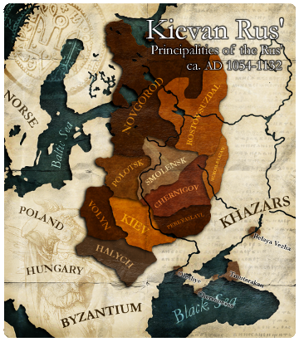
Who has ruled Ukraine?
Kyivan Rus: 879-1240
Grand Duchy of Lithuania: 1240-1569 (329 years)
Polish-Lithuanian Commonwealth: 1569-1795 (226 years)
Russian Empire: 1795-1918 (123 years)
Republic of Ukraine: 1918-22 (4 years)
Soviet Union: 1922-91 (69 years)
Ukraine: 1991-present (31 years)
Poland-Lithuania: 555 years
Russian Empire/Soviet Union: 191 years
Independent: 34 years
Ruled from Moscow: 192 years
Not ruled by Moscow: 590 years
This Photo by Unknown Author is licensed under CC BY-SA-NC

Slide 9
Polish-Lithuanian Commonwealth
This Photo by Unknown Author is licensed under CC BY-SA

